Slide 1
Reframing Multifactor Authentication in Contemporary Cybersecurity
Presented by Sam Fleming

Slide 2
Disclaimers
I am not an MFA expert
This is not an exhaustive discussion
This is not a discussion on which methods are best

Slide 3
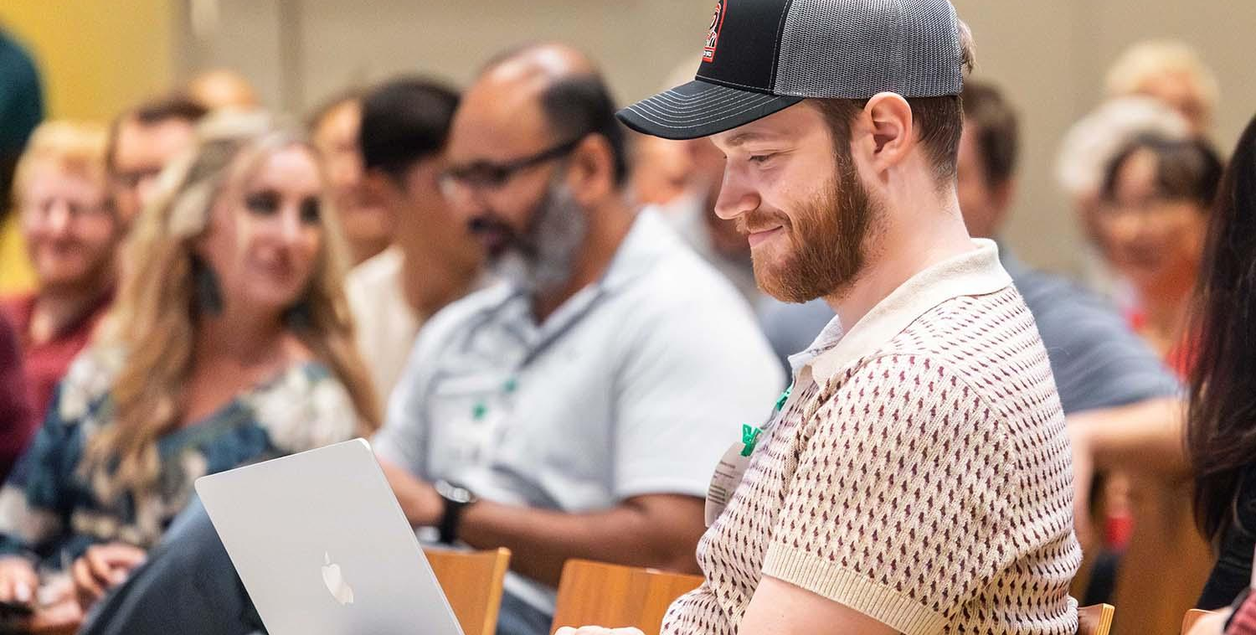
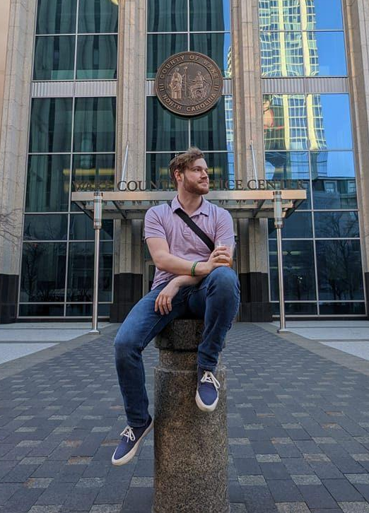
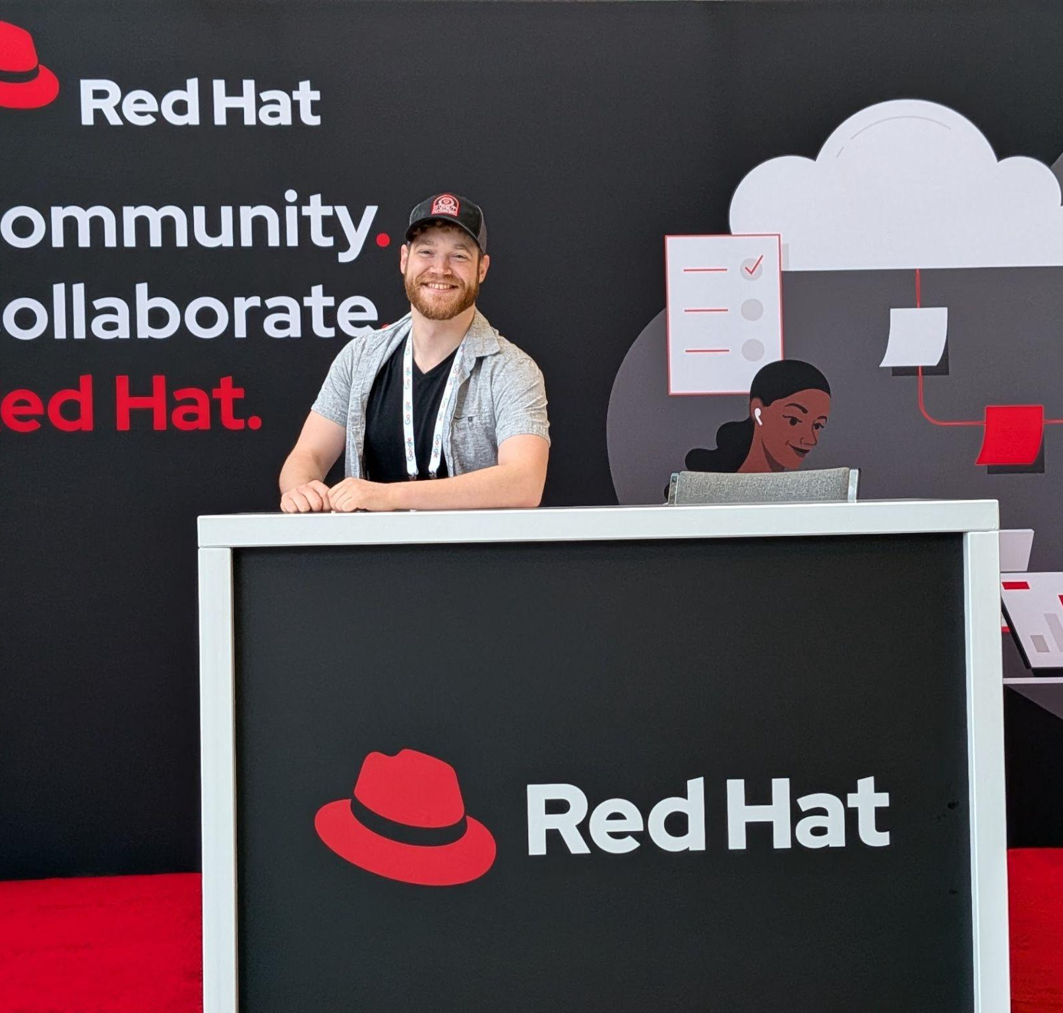
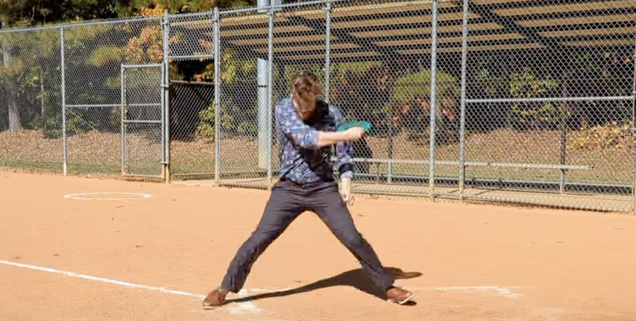

Slide 4
What is MFA?

Slide 5
Definition
Multifactor Authentication (noun):
A security method that requires users to provide two or more verification factors to gain access to an account, application, or system

Slide 6
* Real world poll of my fiancee at 9 p.m. on a Sunday
“
”
That's the thing where a program texts you a code to get in.

Slide 7
The “three factors of MFA”
Something you have
Something you know
Something you are

Slide 8
Current MFA methods
Something you know
  Passwords
  PINs
  Security questions and answers
Something you have
  Mobile phones
  Authentication apps
  Security tokens or key fobs
Something you are
  Fingerprints
  Facial recognition

Slide 9
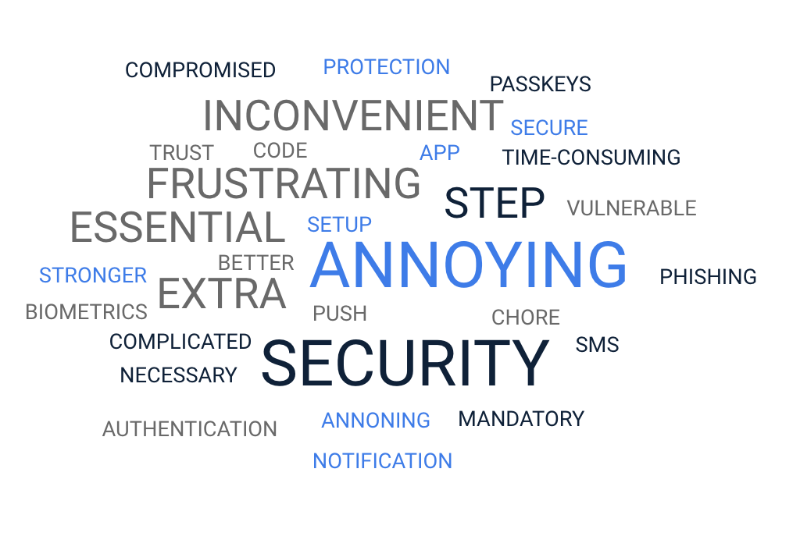
Current perception of MFA

Slide 10
Why the negative perception?
Gradual public release
Viewed as a hindrance
SMS is considered secure

Slide 11
What has been done?

Slide 12
Efforts to promote MFA adoption
Public awareness campaigns
Platforms requiring MFA by default
MFA setup integrated into onboarding
Innovations aimed at improving user experience

Slide 13
Challenges faced by promoters
User fatigue / “MFA fatigue”
Usability issues
Misinformation
Accessibility
Security trade-offs
Organizational resistance

Slide 14
What can be done?
Notes:
Reframing and Strategies for Improvement

Slide 15
Remaining gaps in public perception
Lack of understanding of MFA’s importance
Belief that MFA is complicated or unnecessary
Privacy and trust concerns about biometrics and third-party tools
Limited support for users facing issues
Notes:
Closing these gaps requires targeted education, empathetic communication, and ongoing user support.

Slide 16
How can we reframe these challenges?
Emphasize personal empowerment and convenience over security mandates
Use case studies and real-world scenarios to show MFA's practical benefits
Frame MFA as a proactive step to protect personal and professional digital lives
Stress the positive impact of MFA on daily security habits

Slide 17
Tailor your messaging to your audience's needs

Slide 18
Non-technical users
Use visual metaphors
Give step-by-step walkthroughs
Present in a story format
Relate to everyday tools

Slide 19
Business leaders
Focus on continuing "BAU"
Emphasize maintaining trust
Highlight protecting assets

Slide 20
Technical audiences
Highlight advancements
Identify security integrations
Leverage existing technologies in the conversation
Leave room for them to take the lead
Notes:
Do the opposite of this presentation

Slide 21
Best Practices

Slide 22
What do good adoption practices look like?
Provide clear onboarding instructions and continuous support
Integrate MFA smoothly into existing processes with user-friendly tools
Highlight industry trends towards passwordless solutions to appeal to progressives
Minimize setup friction and encourage user feedback to understand pain points

Slide 23
What does “enhanced” communication look like?
Empathetic communication
  Acknowledge user frustrations!
Clear facts about MFA's importance through targeted content
  FAQs
  Myth-busting articles
  Success stories
Leverage social media platforms (internal and external)

Slide 24
The role of the cybersecurity community and professionals

Slide 25
What is our responsibility in changing perceptions?
Model best practices and articulate MFA's benefits
Share your experiences (good and bad)
Develop and promote user-centric solutions
Inspire voluntary adoption with stories of positive impact
Be the example by implementing/advocating for MFA within your organizations
Collaborate across sectors for unified strategies to foster adoption

Slide 26
What tools or frameworks can actually support community driven efforts?

Slide 27
Collaborative platforms
Slack
Discord
BlueSky
IN-PERSON MEET-UPS!
Notes:
A lot more, so I'll stop now before I get bullied for leaving anything out

Slide 28
Feedback loops
Implement regular feedback within your communities
Use the collected data to iterate and innovate

Slide 29
Success story sharing
Highlight examples of MFA protecting against breaches
Use real-world examples in training sessions
The goal
Make MFA benefits relatable and tangible!

Slide 30
What has worked for me:

Slide 31
Viewing communication as "sales"
Leveraged the "What? So What? Now What?" communication style
Improved user engagement and comprehension
Simplified communication

Slide 32
Reviewed public studies showing MFA trends
Draw parallels to successful corporate strategies
Speak knowledgeably with users of all technical levels

Slide 33
Engaged clients across the hierarchy
Conducted email campaigns and "town hall" meetings to boost security literacy company-wide
Led small group "info sessions" with stakeholders
Refined messaging in both of these formats to solidify understanding

Slide 34
Examples

Slide 35
Positive experience: Yubikeys
Demonstrated the ease of increase security
Fostered acceptance from hesitant users
FOMO

Slide 36
Negative reinforcement: RSA Tokens
Provided TOTP hardware tokens
Assigned additional training
Created a route to simplify upgrades
Notes:
5 out of 8 switched

Slide 37
Conclusion

Slide 38
What can you do?
Practice what you preach
Share your experiences
Use RELATABLE examples
Avoid "technical" descriptions: KISS
Approach with empathy and simplicity

Slide 39
References:
https://pushsecurity.com/blog/which-mfa-methods-should-you-use/
https://fidoalliance.org/fido2/
https://cloudsecurityalliance.org/blog/2020/07/31/strong-mfa-the-first-stop-on-the-path-to-passwordless#
Personal Interview with Jamie Grant, April 25 2025
https://www.researchgate.net/publication/335233025_Evaluating_User_Perception_of_Multi-Factor_Authentication_A_Systematic_Review
https://www.prove.com/blog/prove-identity-2023-state-of-mfa-report-consumer-attitudes-multi-factor-authentication
https://iacis.org/iis/2021/3_iis_2021_69-80.pdf

Slide 40
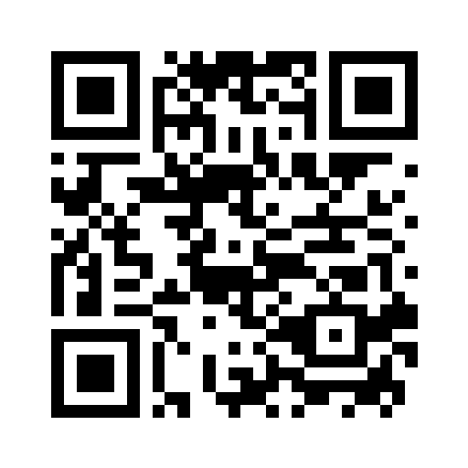
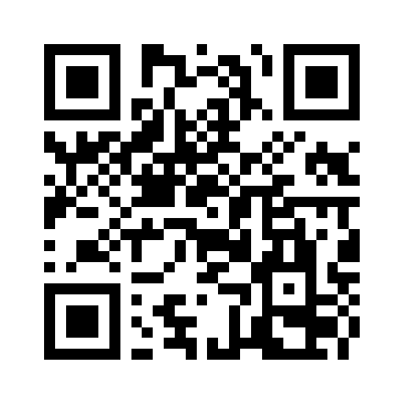
Connect with me:
Links.SamPlaysKeys.com
Github.com/SamPlaysKeys

Slide 41
Thank you!

Slide 42
Reframing Multifactor Authentication in Contemporary Cybersecurity
Presented by Sam Fleming

